Slide 1
Scientific Calculator
Submitted By:
Vedant Patel & Meet Vaghasia
Roll No: 12 & 13
Batch: 14

Slide 2
Introduction
The Calculator was first invented by Casio Company.
The project Scientific Calculator is designed to automate the calculation procedure.
It makes paperwork less and automate the process of calculation.

Slide 3
Objective and Scope
Our objective was to create a Basic Scientific Calculator, which have more functions than a Standard Calculator.
Our project will be able to implement in future after making some change and modification as we make our project at very low level. So the modification that can be done in our project are:-
Adding function (e.g. Hex ,Oct , sinhx)
More interactive (Design)
Implement our project in different language like java , python in this language program work efficiently.

Slide 4
Problem Statement
Create a calculator using c programing language which perform simplest calculator’s task as well as sophisticated calculators
A calculator is a device that performs arithmetic operations on numbers. The simplest calculators can do only Addition, Subtraction, Multiplication, and Division. More sophisticated calculators can handle Exponential operations, Roots, Logarithms and Trigonometric functions.

Slide 5
Solution Proposed
A Scientific Calculator program makes calculation easy as well as if we forget our Scientific Calculator device then we have an alternative in our system.
We can use Scientific Calculator program to continue our calculation .

Slide 6
System Requirements
Software Requirements:
Linux OS or a C Compiler
Hardware Requirements:
CPU Type | Pentium 4 or higher; 2 GHz or higher
Memory/RAM | 1 GB minimum, up to the system limit
Hard Disk | 4 GB minimum

Slide 7
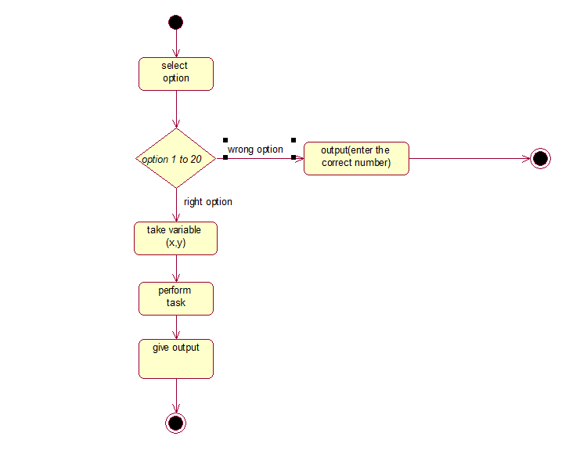
System Flow chart

Slide 8
Modules
Arithmetical Module:- Addition , Subtraction, Multiplication, Division, Modulo.
Trigonometric Module:- sin , cos , tan , cosec , sec ,cot, log.
Power Module:- Power Function , Exponent Function.
Root module:-Square Root , Cube Root.

Slide 9
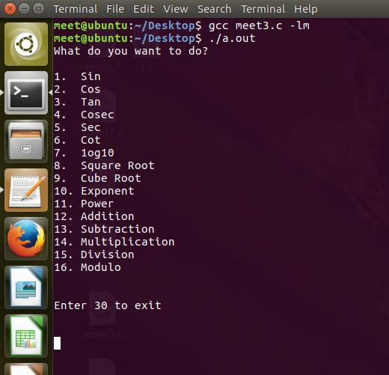
Screenshots

Slide 10
Conclusion
A simple user interface has been created to demonstrate the calculator. The interface addresses the problem of allowing the user to enter the values and proceeds giving an answer which can be used or checked.
And the user can continue to use the Calculator upto the user’s wish.

Slide 11
References
https://en.wikipedia.org/wiki/Scientific_calculator

